Slide 1
Migrating the Monolithic to the Microscopic
Many people are talking about adopting microservices and moving away from the monolithic application. But how do you go about moving to a microservices based architecture? How do you host your microservices reliably on Azure Service Fabric? In this session we’ll provide a brief review of microservices and Service Fabric principals. We’ll then quickly move into a through discussion of field proven strategies for transforming development and IT teams to utilizes these technologies. We’ll review real-world customer examples of how to best handle deployments, monitoring, securing, and generally managing services with Azure Service Fabric.

Slide 2
Migrating the Monolithic to the Microscopic
Michael S. Collier
CodeMash 2017
Friday, January 13th @ 9:45am in Salon A
Notes:
Understand the options available and have a good baseline for making choices for your solutions.

Slide 3
Michael S. Collier
Senior Software Development Engineer,
DX TED – Global Commercial ISV
michael.collier@microsoft.com
@MichaelCollier
www.MichaelSCollier.com

Slide 4
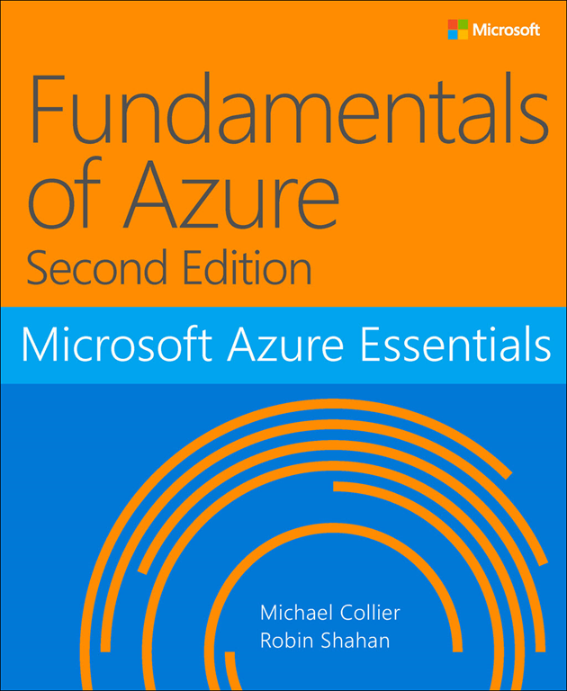
http://aka.ms/FundAzure2e

Slide 5
Why Microservices?
Notes:
Premise: there has been a pivot in the focus of software development away from large monolithic systems for enterprises to smaller systems targeting consumers
Result: horizontally-scaled applications on commodity hardware with short upgrade cycles. This presentation is about how best to handle the fragility of the environment – both in hardware and development cycles.

Slide 6
Scalability
Enterprise scale
Large organizations
Employee-focused applications
Vertically-scaled applications on expensive hardware
Long upgrade cycles
Webscale
Small organizations
Externally-focused applications
Horizontally-scaled applications on commodity hardware
Short upgrade cycles
Notes:
Two ways to look at Scalability
Enterprise Scale
Large organizations
Used by employees
Long replacement cycles
Scales vertically
Webscale (relatively modern)
Small organizations
Used by public
Short replacement cycles
Scales horizontally
Example: Google
Commodity hardware => Fragile
Cloud

Slide 7
Fragility
Design for failure
Resilience
SLA
System
Automated deployment
Health monitoring
Application
Loosely-coupled services
Limit surface area
Fault isolation
Notes:
One of the problems caused by using commodity hardware with frequent software upgrades is fragility.
Combat fragility by designing for failure.
Design for Failure
Public cloud is a fragile environment
Need to handle fragility
Build resilience into the system – isolate faults; alternative paths
SLA – no public cloud offers 100% uptime SLA. 99.95% - be prepared for some downtime!
Limit surface area / interaction points of systems
Fault isolation
Antifragility is beyond resilience or robustness. The resilient resists shocks and stays the same; the anti-fragile gets better – Nassim Nicholas Taleb
Azure Virtual Machines SLA is 99.95% => 21.6 minutes a month

Slide 8
State
Stateless systems
Horizontal scale out for performance
Load balanced
Stateful systems
Partition the data across compute nodes for scale
Create multiple replicas of each partition for availability
Understand the implications of the CAP theorem
* (Consistency, Availability, Partition Tolerance)
Notes:
When building microservices, we need to be concerned with how we manage state.
Stateless Systems
Horizontal scaleout for performance
Load balanced
Stateful Systems
Partitioning for performance goes back to the 1970s
Horizontal scaleout of state
Not sufficient in a fragile system
Need replicas of each partition
AWS DynamoDB -> Cassandra | Azure Storage
High-scale stateful system needs partitions with replicas

Slide 9
Organizational challenge
Traditional
Large teams
Independent developer and operations teams
Strong dependencies
Lots of meetings
Modern
Small teams
Devops
Slack
Notes:
Enterprises are typically organized in one of two ways:
Traditional
Large teams
Independent developer and operations teams
Strong dependencies
Lots of meetings
Modern
Small teams
Devops
Slack
Conways Law
Designs mirror the communication structure of organizations
organizations which design systems ... are constrained to produce designs which are copies of the communication structures of these organizations
— M. Conway

Slide 10
“ organizations ... produce designs which are copies of the communication structures of these organizations”
Melvin Conway
Notes:
The basic thesis of this article is that organizations which design systems (in the broad sense used here) are constrained to produce designs which are copies of the communication structures of these organizations. We have seen that this fact has important implications for the management of system design. Primarily, we have found a criterion for the structuring of design organizations: a design effort should be organized according to the need for communication.
http://www.melconway.com/Home/Committees_Paper.html

Slide 11
Hosting Microservices
Needs
Environment capable of hosting microservices
Service discovery
Health monitoring
Automated deployment
Orchestration/scheduling
Notes:
We want to produce smaller, more flexible services that when composed are a larger solution.
What do we need to host those shiny new bits?

Slide 12

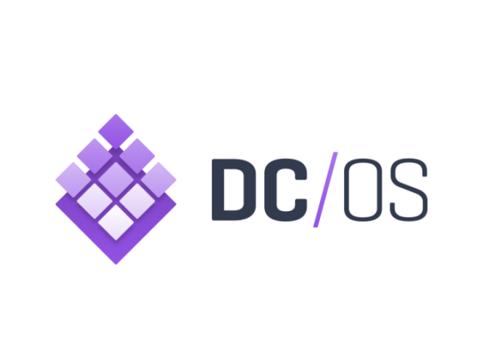
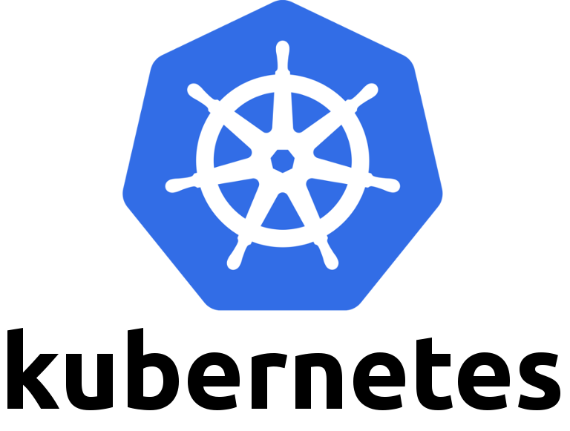
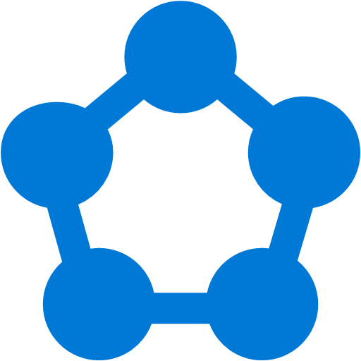

Hosting Microservices in Azure
Azure Container Service
Virtual Machines
Service Fabric cluster
Azure App Service
Notes:
Service Fabric Comparison
Docker Swarm
Kubernetes
Mesos DC/OS
Azure Service Fabric
https://azurecomcdn.azureedge.net/cvt-9dec20136a2d6657f9348c8cdd789f47f3a0bc04ef495ad8d75c8cd171adbe0a/images/page/services/container-service/03-scale.png

Slide 13
The Continuum
Service Fabric provides the platform
Pure IaaS
Unstructured PaaS
Structured PaaS
Pure PaaS
IaaS
PaaS
Virtual Machines
Containers
Service Fabric
Cloud Services
App Service
VMSS
In Azure, Service Fabric sits on top of Virtual Machine Scale Sets (VMSS).
Notes:
If we step back & look at where SF fits on the IaaS to PaaS continuum, I think it fits somewhere between a Pure IaaS and Pure PaaS model. It’s not as completely “hands-off” as App Service, and requires a little more management than Cloud Services. Yet, SF doesn’t require you to build everything, like you would with VMs, or compose various frameworks and tooling as you would with a containerized approach. There is some structure to Service Fabric’s model – you leverage it’s model for configuration and coding against its APIs. Yet you have to mange the VMSS it relies on for hosting.

Slide 14
Service Fabric Overview

Slide 15
Write Once, Run Anywhere
Microservices
Service Fabric
Container Orchestration & lifecycle management
Application Programming Models
High Availability
Hybrid Operations
Data Partitioning
Health Monitoring
Self-healing
Simple programming models
High Density
Rolling Upgrades
Low Latency
Placement Constraints
Replication & Failover
Stateful services
Fast startup & shutdown
Load balancing
Hyper-Scale
Automated Rollback
Windows
Server
Linux
Windows
Server
Linux
Windows
Server
Linux
Azure
Private Clouds
Hosted Clouds
Notes:
Your choice of hosts
Azure
Other Public Clouds
On-Premises (preview)
Your choice of OS
Windows
Linux (preview)
Local development experience
The same code running on your local box as in Azure. Not an emulator with some reduced features . . . . Looking at you Cloud Service (can this be a fun picture?)
Create a dev machine in Azure. SF can get a bit large on a local box - leverage Azure VMs.
Shut down the VMs when not in use / stop the cluster. Don't need to remember to do so on local box. Save some resources (esp. if running on a relatively low powered machine like a Surface Pro)

Slide 16
Service Fabric Overview
Service types
Reliable Services
Stateful Service
Stateless Service
Reliable Actors
Reliable collections
Provide state for a stateful service
Partitioned across stateful reliable service instances
Two types
Reliable Dictionaries
Reliable Queues
Notes:
Service Fabric Overview
Reliable Services
Partitions
Stateless Services
Stateful Services
Reliable Actors
Deployment Model
Synthetic resource provider
VMSS
Durability tier
Reliability tier
Placement properties
Capacity properties
Secure (KeyVault) / Unsecure

Slide 17
Azure Deployment of Service Fabric
Cluster
Service orchestration across a cluster of machines
Each node type is implemented as a VM Scale Set with homogenous VMs
Automatically handle node failover, health monitoring, etc.
VMs use platform or custom image
VMs not upgraded automatically
Autoscale the hosting VM Scale Set
Partitioning of stateful services
Management Services
Deployed automatically into the cluster
Deploy and upgrade with little/no application downtime
Service discovery
Upgraded automatically
Notes:
Service Fabric Overview
Reliable Services
Partitions
Stateless Services
Stateful Services
Reliable Actors
Deployment Model
Synthetic resource provider
VMSS
Durability tier – determines allowable SKU type. Bronze: A, D, DS. Gold: G5
Reliability tier – determines initial node count. Bronze: 3 -> Platinum: 9
Placement properties – name/value pairs
Capacity properties – name/value pair
Secure (KeyVault) / Unsecure

Slide 18
Why Migrate to Service Fabric?
Notes:
Why are people are migrating to Service Fabric?

Slide 19
Why are you doing this?
Cost Model
Traditional PaaS (Cloud Services) was a node-based density model
Alignment of team to functionality
Agility
Testability
Efficiency
Supportability
Deployment Efficiency
Near instant deployment
Zero downtime upgrades
No impact to other services
Notes:
3 main reasons customers are migrating to Service Fabric:
Cost Model – more efficient use of resources in Azure
Alignment of TEAM to FUNCTIONALITY –
Developers / IT Pros – more efficient deployment w/ faster upgrades and isolated changes.

Slide 20



Move Beyond Cloud Services
Cloud Service – Deploy code to Azure-managed VMs
WebRole1
WorkerRole1
WorkerRole2
Notes:
When coming to SF from CS, one of the big advantages is moving beyond what CS can provide. Specifically, how the application model aligns to VMs.
CSDEF – Specify the various roles you would like to have. Perhaps you will have a Web Role and a few Worker Roles. Typically, this is modeled in such a way as one application per role. You then specify the initial number of instances for that role – which equates to the number of VMs to deploy. You’re deploying code assets to VMs managed by Azure. Your density is very low – 1 app to 1 VM (typically).
With this approach, there is no native way of modeling an application. Is the application your Cloud Service? Is it multiple Cloud Services? Are the roles even related – often yes, but nothing defines that relationship.
You end up with some VMs that Azure manages, which happen to have your code assets deployed.

Slide 21
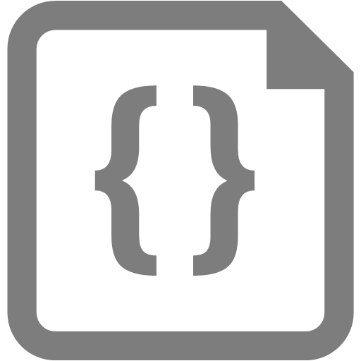


Move Beyond Cloud Services
Cloud Service – Deploy code to Azure-managed VMs
Not supported in Azure Resource Manager
Service Fabric – native application support
Application platform
VMs abstracted behind the application model.
Application
Service
Service
Service
Code
Config
Data
Code
Config
Data
Code
Config
Data
Notes:
Applications are packages, copied to the cluster, then registered as an Application, complete with versioning semantics, complete w/ multiple versions of an application (helpful in some multitenant scenarios).
An Application can then contain 1 or more services, each of those with their own Code, Configuration, and Data package, all of which are versioned.
Once the SF cluster is created, you as an application developer have very little knowledge, or need, to know how the VMs are modeled. The infrastructure is largely abstracted behind the model defined by Service Fabric.
Services are defined as a ServiceType with ServiceTypeVersion in a Service Package that also has Code, Config & Data packages (each package is versioned).

Slide 22
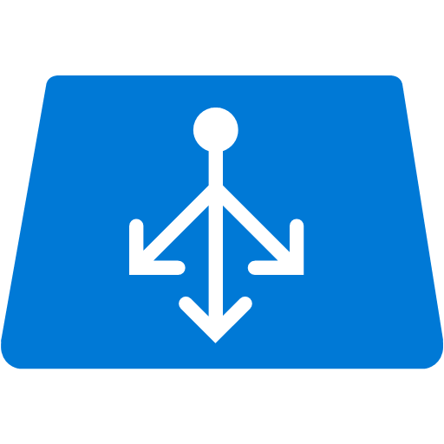



State Management
Externalized State with Cloud Service or App Service
Front End
(Stateless Web)
Stateless
Middle-tier Compute
Cache
Queues
Storage
Notes:
When we look at how state is managed in a CS or App Service, we often see something similar to what you see here. With a CS or App Service, stateless compute nodes are defined, and any state and related data is pushed to external data stores – Redis Cache, SQL DB, DocDB, Table Storage, etc. The more tiers, and interaction between tiers, and thus state that is needed, this picture gets increasingly complex.
As previously discussed, one of the key design principles with microservices is keeping your state and compute close together.
If your current solution is built in such a way, migrating to a microservices architecture hosted with Service Fabric will be easier.

Slide 23


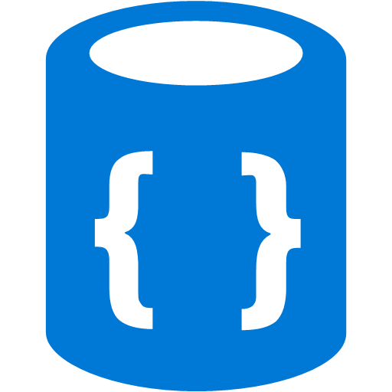
State Management
Service Fabric - Stateful or Stateless? External?
Notes:
When we look at Service Fabric, you can have a similar approach, from a high level perspective. You have Reliable Services for your various compute nodes. State can optionally, as modeled here in the middle, be coupled with the service as a stateful Reliable Service with its Reliable Collections.
Nothing says you HAVE TO keep all state within Service Fabric though. It is perfectly OK to keep state externalized. There are a variety of reasons to do so. Perhaps the solution takes advantage of features specific to that data store, or other systems need to access that data, just as a few examples.
In the end, the choice is yours as the developer / architect on where and how to manage state for your application.

Slide 24
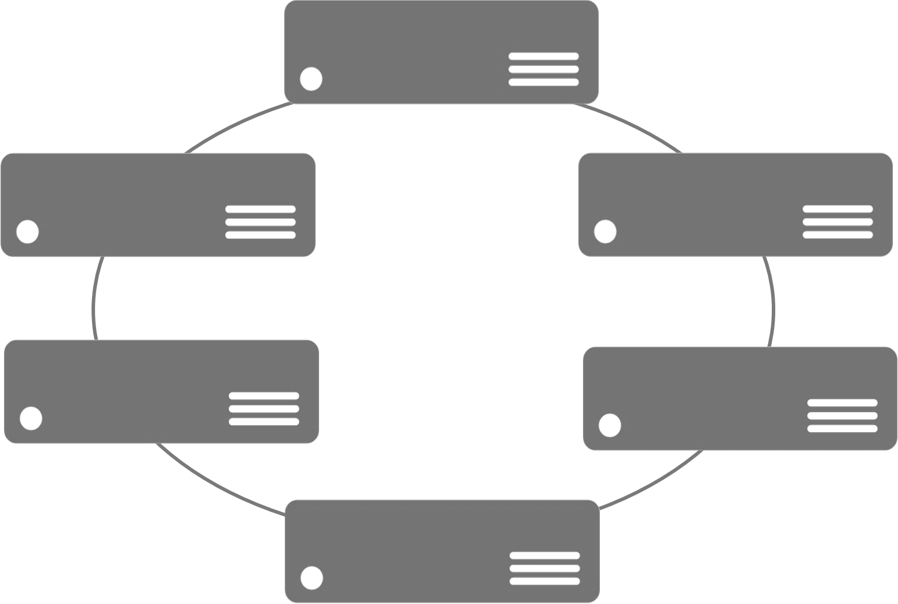
Compute Density
VM Size & Partition Count Matter
Data is stored in memory
Partition count is fixed
Favor more partitions than nodes
Smaller partitions easier to copy
Node Types -> VMSS
Web Sites vs. Backend Services
High Memory vs. Low Memory
Notes:
If we now step back and consider the cluster infrastructure and how it is related to Service Fabric, it’s important to keep in mind two things – VM size and partitions. While Service Fabric is an application platform, and from a developer perspective isolates you from the underlying infrastructure, it doesn’t shield you from it completely. You still need to have some notion of VM size. Why? Because if you’re using Reliable Collections, that data is stored in memory. So the size of the VM matters.
You also need to think through how many partitions you want in your application services. Once that number is set, it can’t be changed. Typically, you’ll want to have more partitions than you do nodes, as this allows you to scale easily.
Smaller partitions are easier to move around to new nodes. Less data to move between the replicas. It’s easier to move many small things than a few very large things.
Additionally, as previously mentioned, the Node Types in Service Fabric are directly related to VMSS. This allows you to place your services on VMs that are appropriate for the corresponding workload.

Slide 25
DevOps
Rapid Deployment & Upgrades
Seconds with Service Fabric vs. minutes for Cloud Services
Advanced Lifecycle Management
Azure Resource Manager
Fault Recovery
Health Metrics
Built-in Testability / Faults
Infrastructure Management / VMSS
VM / node type – you
VM patching – you (currently)
Service placement constraints - you
Notes:
Another reason people may migrate to Service Fabric is it’s propensity to support a DevOps model.
Rapid deployments – especially when compared to Cloud Services.
Native lifecycle management features – ARM, fault recovery (being the ability to move services from unhealthy nodes to healthy nodes), and a native ability to inject faults into your system to see how it behaves.
Additionally, as we’ve previously mentioned, SF still requires you to manage the infrastructure. You’re responsible for selecting the node type, patching the VMs, and determining where services should be placed.
Service Fabric doesn’t 100% shield you from the operations of the cluster. It really depends on the hat you wear. ☺

Slide 26
A Platform for Microservices is not Free
Problems to Solve
Service Availability
Resource Allocation
State Management
Versioning
Independently upgradable services / data
Roll backs
You provide the design & code
You can still write monolithic applications and do bad things!
Notes:
As mentioned earlier, there are many important things to consider when running a microservices solution. How to:
Service Availability
Resource Allocation
State Management
Versioning
Upgrades, roll backs, side by side deployment
All that comes at some cost. Service Fabric as a platform provides those features.
Yet, nothing in SF prevents you from doing bad things. You can still write a monolithic application with Service Fabric. Probably not wise, but doable. You have to build the solution “the right way”.

Slide 27
Migration Pattern
Notes:
Let’s now take a look at a pattern for migrating to Service Fabric.

Slide 28
The Master Plan
Phase 1
Phase 2
Phase 0
Get Modern
Migrate the Application
Modify the Application
Notes:
0 – (Optional) Pay down technical debt
1 – Migrate the application with minimal changes
2 – Modify the application to leverage SF platform benefits
Step into these . . .

Slide 29
Phase 0 – Pay Technical Debt
Get current on Azure SDKs
Support for async methods and improved retry policies
Update to ASP.NET MVC 5 / ASP.NET Core
Async controllers
Modern view engine
Azure AD using Open ID
Replace WS-Federation
Azure Redis Cache
Replace Azure In-Role Cache (no longer supported)

Slide 30

Phase 1 – Benefit ASAP
Move the minimum
Realize the benefit of the platform – stateless reliable services
Keep code changes to a minimum
Keep external dependencies / state as is
Cloud Service
Application Package
Web Role
Web Service
Worker Role
Worker Service
Fast deployment times.
High-density hosting.
Run anywhere.
Notes:
Stateless
https://azure.microsoft.com/en-us/documentation/articles/service-fabric-cloud-services-migration-differences/

Slide 31
Phase 2 – Platform Advantage
Adjust to take advantage of Service Fabric platform
Move data stores to stateful Reliable Services
Keep some data stores as is. Is there a benefit?
Communication Pattern
Direct – change the code to use the Naming Service
Queues – still an option.
Notes:
Internal vs. external queues

Slide 32
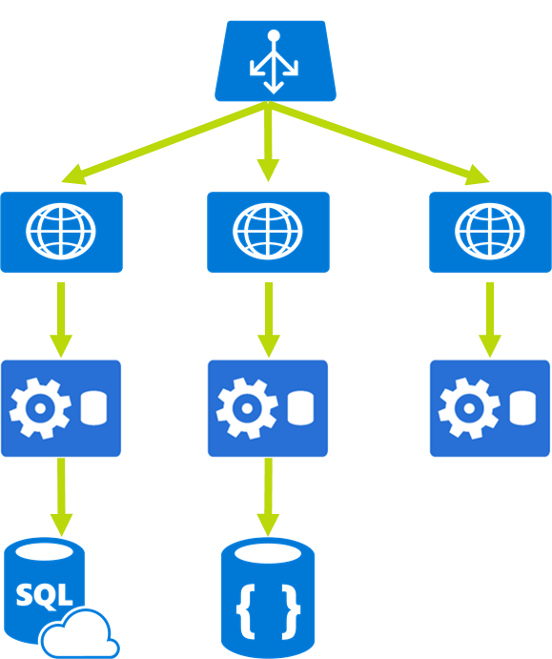
Data Used by Other Systems
Continue to use an external data store
Don’t have to use Reliable Collections!
Access via service endpoints
Notes:
https://azure.microsoft.com/en-us/documentation/articles/service-fabric-reliable-services-backup-restore/

Slide 33



Customer Scenario
“If you create microservices in Azure, you do it in Service Fabric.”
Magic
“Service Fabric is the evolution of Cloud Services. It’s PaaS v2!”
“I want to write code, not manage VMs.”
Notes:
The promise
This is a simplified view of this customers high-level architecture.

Slide 34

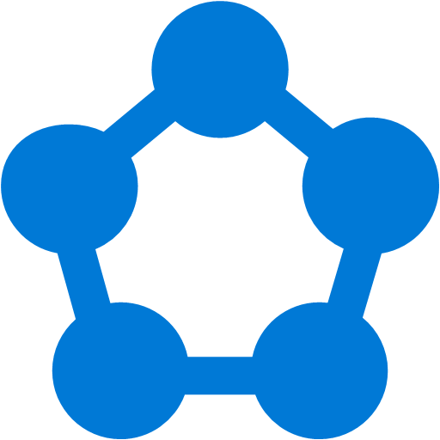

Customer Scenario
“I want to manage code, not VMs.”
“I need to ship code . . . Now!”
DevLaptop
DevLaptop
DevLaptop
DevLaptop
+
or
VMSS
Service Fabric
What the . . .
What size VMs/nodes?
How many node types / VMSS?
What’s the best strategy to patch the VMs?
How do I secure these VMs? SF management console?
What’s the best approach to monitor the VM health?
3-Node Dev Cluster
5-Node Production Cluster
“No time to try, test, try again to get cluster config right.”
Notes:
The reality
Red Flags
A lot more to Service Fabric than just getting the application / development model right. Also need to dedicate time to getting the infrastructure & operations aspects right too.
When working with your customers, make sure you help them account for this in their planning. Be prepared to address this work early in the process.

Slide 35

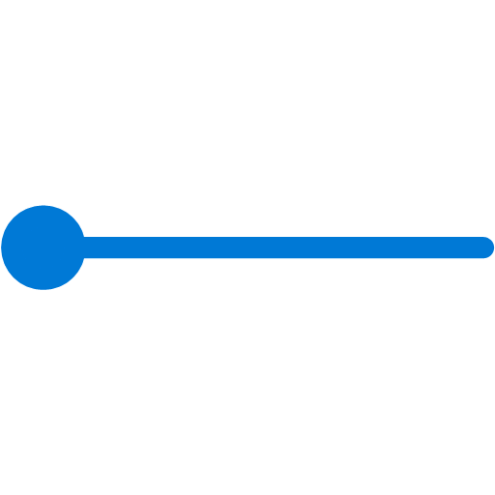

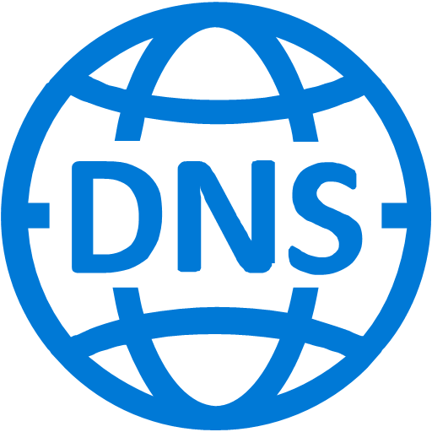



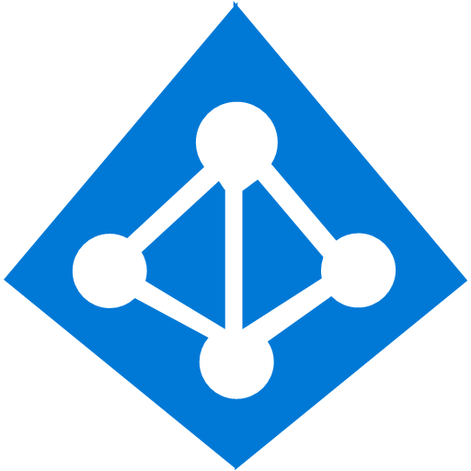






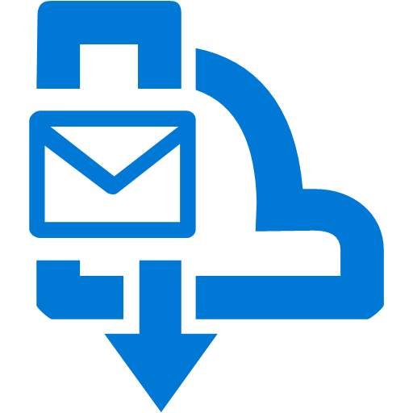
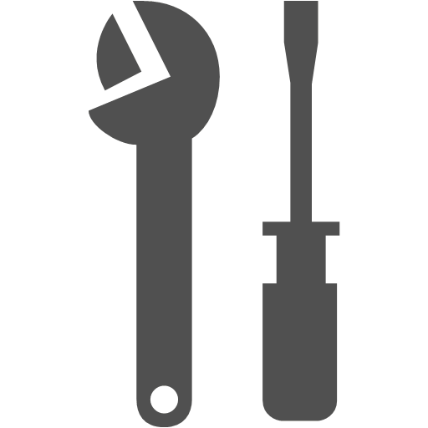





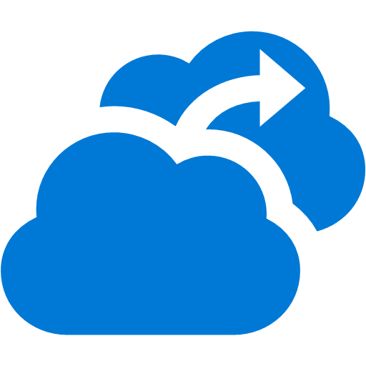
Customer Environment Topology
Mgt.
User
Limit RPC access to range of IPs
Authenticate against POD AAD
Global Resources in Primary Subscription
Browser Clients
Non-compute Azure resources
Common VNET for PROD POD
Service Fabric Cluster
Load Balancer
URL Router
[NGinX]
(Public IP/DNS Name)
Load Balancer
FrontEnd
Node Type
Public Web Sites & Services
BackEnd
Node Type
Framework Services
Ingestion
Node Type
Ingestion Worker Services
Management
External Doc Sharing
Mgt. Node
Splunk Server
Source Systems
Mobile Devices
Storage Resources
All in primary subscription
Tenant N Resources
Tenant N Storage
Global Storage
Tenent 2 Resources
Tenant 2 Storage
Tenant 1 Resources
In tenant owned subscription
Tenant 1 Storage
= VNet
= SubNet
= Svc. Fabric Cluster
= AAD Domain Svcs.
= Azure Subscription
= Azure Storage Account
= SQL Database
= Data Replication
= Security Group
= VM Scale Set
= Key Vault
= Azure Active Directories
= Service Bus
= Service Bus Topic(s)
= Service Bus Queue(s)
= Event Hub
Notes:
Medical services provider
Traditionally on-premises
Moved to Cloud Services
Saw the writing on the wall -> Service Fabric
Nginx as a reverse proxy to help with keeping the endpoints consistent. Potentially use SF’s built in reverse proxy in recent SDK.
FrontEnd – public facing web applications
BackEnd – APIs consumed only by the FrontEnd and Ingestion
Ingestion – Services to reach to customer storage locations to retrieve data
Management subnet containing a jumpbox
NSGs to secure traffic from Nginx and Management tier
Dependencies on non-compute resources (originally started in the Cloud Service days0

Slide 36

Security
Certificate
Securing intra-cluster communication
Securing intra-service communication
Authentication
AAD vs Certificates
Network isolation
NSG, Subnet, jump box
Connectivity to Service Fabric Resource Provider
Notes:
Security was a major point of concern for this customer
HIPPA states need encryption between all services. Problem with INTRA-service communication.
SF Naming Service returns an IP address.
SSL requires a domain name (cert validation) – disable strict certificate checking
X509 certificates to connect to management endpoints
Can also now do AAD (preferred . . . Example later)

Slide 37
Migrate a Cloud Service to Service Fabric

Slide 38
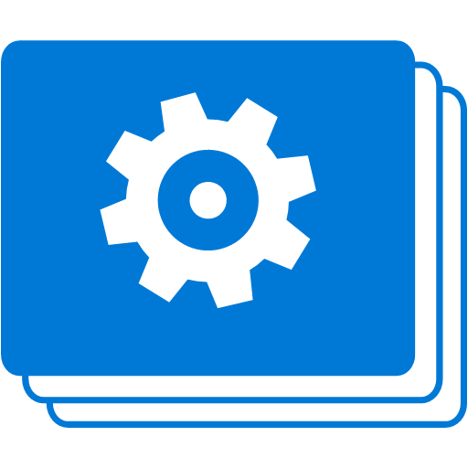


CryptBit Demo Application Overview
Standard 3-tier architecture with external state
Web Role - ASP.NET MVC and Web API
Worker Role – Background processing
Storage – Blobs, Tables, Queues
Azure Key Vault – Encryption key management (client side encryption libraries)
AAD – Authentication to Key Vault via ADAL

Slide 39
CryptBit Demo Application Overview
Standard 3-tier architecture with external state
Web Role - ASP.NET MVC and WebAPI
Worker Role – Background processing
Storage – Blobs, Tables, Queues
Azure Key Vault – Encryption key management (client side encryption libraries)
AAD – Authentication to Key Vault via ADAL
Cloud Services - https://github.com/jvallery/CryptBitCS
Service Fabric - https://github.com/jvallery/CryptBitSF
Update links

Slide 40
CryptBit Cloud Service Architecture
Cloud Service Application
CryptBitWeb (Web Role)
CryptBitService (Worker Role)
Encryption Key
Enqueue
Dequeue
Download, Compress, Upload, & Delete
Upload
Key Vault Secret; Status Update

Slide 41
Migrating a Cloud Service to Azure Service Fabric
A comparison walkthrough
Notes:
Show CryptBitCS running
Show the migrated version, CryptBitSF
Show deployed to secured SF cluster with AAD
Show placement constraints

Slide 42
CryptBit Service Fabric Architecture
Service Fabric Application
CryptBitWeb (Stateless Service)
CryptBitService (Stateless Service)
Encryption Key
Enqueue
Dequeue
Download, Compress, Upload, & Delete
Upload
Key Vault Secret; Status Update

Slide 43
What Did We Do?
Worker Role to Stateless Service
Continue to use Azure Storage
Changed where app configuration values stored
Web Role to Stateless Service
Can’t depend on IIS → OWIN
No dependency on System.Web
Application Type | Easy support path | Long term strategy
Web Role (ASP.NET Web Form) | No support Container | Convert to ASP.NET Core 1 MVC
Web Role (ASP.NET MVC) | No support Container | Convert to ASP.NET Core 1 MVC
ASP.NET Web API | OWIN | Convert to ASP.NET Core 1
ASP.NET Core | Yes | N/A
Notes:
ASP.NET MVC takes a dependency on System.Web and IIS – not supported in Service Fabric.

Slide 44
What Did We Do?
Code
Application configuration values (RoleEnvironment vs. CodePackageActivationContext)
Set up OWIN for ASP.NET Web API
SPA app
Cloud Services → VM; Service Fabric → service
Deployment
Via Visual Studio with PowerShell script
Notes:
No RoleEnvironment class in ServiceFabric; most often use CodePackageActivationContext in ServiceFabric
Any code logic that is related to a VM (lifetime or configuration) needs to be changed. In Service Fabric, you’re working with a service which can move around VMs/nodes.

Slide 45
What Did We Do?
Secure Cluster
Azure AD for management authN
Certificates for client authN
Hosting
Two node types (3 each for dev / 5 for production)
Placement constraints
Notes:
No RoleEnvironment class in ServiceFabric; most often use CodePackageActivationContext in ServiceFabric
Any code logic that is related to a VM (lifetime or configuration) needs to be changed. In Service Fabric, you’re working with a service which can move around VMs/nodes.

Slide 46
What Did We NOT Do?
Secure Secrets
Automation
Automate deployment
ARM Template for Service Fabric Cluster

Slide 47
Key Differences
 | Cloud Service | Service Fabric
Application composition | Roles | Services
Density | One role instance per VM | Multiple services in a single node
Minimum number of nodes | 2 (for SLA) | 3 for testing; 5 for production
State management | Stateless | Stateless or Stateful
Web hosting | IIS | Self-hosting
Deployment | Classic (ASM) | Resource Manager (ARM)
Packaging | Cloud service configuration (.cscfg) | Application and service packages
Application update | VIP swap or rolling update | Rolling update
Auto-scaling | WASBi / yet another service | VM Scale Set
Debugging | Local emulator | Local cluster
Startup Tasks | CSDEF startup task | Entry point in service manifest
Configuration management | CloudConfigurationManager (node specific) | CodePackageActivationContext (service instance specific)
Notes:
https://azure.microsoft.com/en-us/documentation/articles/service-fabric-cloud-services-migration-worker-role-stateless-service/

Slide 48
What to Watch for?
Capacity Planning
Communication Model
Diagnostic / Logging
Security Model
Multi-region deployment
Network Model
VM Customization
Disaster Recovery
VM Maintenance
Notes:
Don’t be afraid of moving to Service Fabric! It can be a great thing!! Be aware of the things you need to do to be successful. There is more to it than the traditional Cloud Service. That’s not a bad thing . . Just be aware so you can plan accordingly.

Slide 49
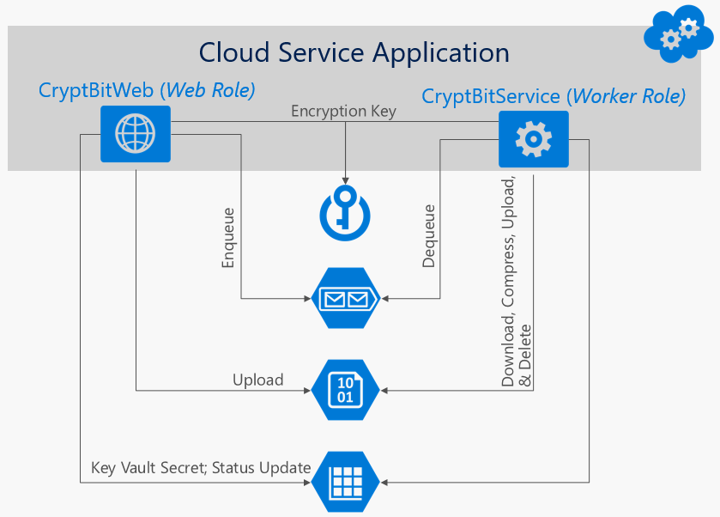
Add Another Web App?
Cloud Service Application
CryptBitWeb (Web Role)
207.12.4.6
157.2.12.6
* Complete made up IP addresses. I have no idea if these are legit. Seriously!
Notes:
What if we were to have had two Cloud Services that make up our application?

Slide 50



Routing Client Requests to the Application
External Load Balancer
External Load Balancer
App Gateway
VMSS Cluster
VMSS Cluster
VMSS Cluster
Network Virtual Appliance
Service Fabric Reverse Proxy
VMSS Cluster
http:/host/ApplicationName/ServiceType/application-url-path/
Custom Gateway Service
Notes:
External load balancer
Define LB rules to map port to service listening port
Single IP address
Multiple load balancers
Separate IP addresses
Placement constraints to place service in proper nodes
App Gateway (layer 7 routing)
Two+ services appear as single domain name (URL path routing)
Network Virtual Appliance w/ layer 7 routing
Third-party NVA (e.g. nginx)
Already using a NVA (e.g. firewall)
Service Fabric Reverse Proxy
All services with HTTP endpoints
URL coupled to app instance names & service types
Rewrite HTML links
Best for Web API (or service-to-service)
Custom Gateway Service
Requests routed through LB to gateway, then to desired service.

Slide 51
Resources
Service Fabric common questions
https://docs.microsoft.com/en-us/azure/service-fabric/service-fabric-common-questions
Placement Constraints with Service Fabric
https://brentdacodemonkey.wordpress.com/2016/09/11/placement-constraints-with-service-fabric/
Migrate from Cloud Services to Service Fabric
https://docs.microsoft.com/en-us/azure/service-fabric/service-fabric-cloud-services-migration-worker-role-stateless-service

Slide 52
A Crash Course on Building Microservice-based Architectures
12:15pm
Zambezie
Shawn Wallace

Slide 53
Questions?

Slide 54
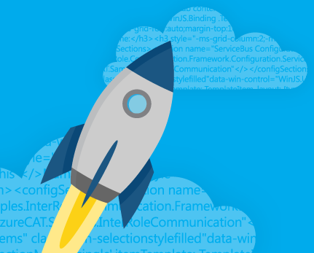
Thank You!
Michael S. Collier
@MichaelCollier | www.michaelscollier.com
michael.collier@microsoft.com

Slide 55
Routing Client Requests to the Application
External load balancer
Define LB rules to map port to service listening port
Single IP address
Multiple load balancers
Separate IP addresses
Placement constraints to place service in proper nodes
App Gateway (layer 7 routing)
Two+ services appear as single domain name (URL path routing)

Slide 56
Routing Client Requests to the Application
Network Virtual Appliance w/ layer 7 routing
Third-party NVA (e.g. nginx)
Already using a NVA (e.g. firewall)
Service Fabric Reverse Proxy
All services with HTTP endpoints
URL coupled to app instance names & service types
Rewrite HTML links
Best for Web API (or service-to-service)
Custom Gateway Service
Requests routed through LB to gateway, then to desired service.
http:/host/ApplicationName/ServiceType/application-url-path/

Slide 57
Challenges of creating applications
Fragile environment
Webscale
Distributed teams
Frequent upgrades
Notes:
Agility
Software Systems - monolithic
Tightly coupled (Strata)
Long development cycle
Hard to understand / Challenging to change
Difficult to deploy in the cloud
Fragile

Slide 58
Microservices
Definition
Application created by connecting small services
Each service does one thing well
Use bounded context for data
Use versioned interfaces for services
Each service is easy to understand
Service lifecycle owned by a small team
Benefits
Services are loosely coupled
Each service is independently deployable
Services have short development cycles
Stateless services replicated for availability
Stateful services partitioned for scale
Stateful services replicated for availability
Testability
Notes:
Microservices
Definition
Aggregation of small services
Service does one thing and does it well
Owned by a small team (Conway's Law, 2-pizza team)
Easy to understand
Bounded context
Versioned
Benefits
Independently upgradable
Short development cycle
Loosely-coupled services (relationship not strata)

Slide 59
“ Loosely coupled service oriented architecture with bounded contexts.”
Adrian Cockcroft
Notes:
"Loosely couple service-oriented architecture with a bounded context" – Cockcroft
http://www.slideshare.net/adriancockcroft/dockercon-state-of-the-art-in-microservices

Slide 60
Key Differences
 | Cloud Service | Service Fabric
HTTP Hosting SSL, port bindings, routing | IIS | Self hosted via OWIN
Configuration Management | CloudConfigurationManager (node specific) | CodePackageActivationContext (service instance specific)
Configuration Change Notification | RoleInstance.Changed | CodePackageActivationContext
Deployment | CSPKG to old portal | Deployed to existing local or prod cluster as a service instance XML publish profiles
Startup Tasks | CSDEF startup task | Entry point in service manifest
Notes:
https://azure.microsoft.com/en-us/documentation/articles/service-fabric-cloud-services-migration-worker-role-stateless-service/

Slide 61
Supported migrations and target
Application Type | Easy support path | Long term strategy
Web Role (ASP.NET Web Form) | No support | Convert to ASP.NET Core MVC Container
Web Role (ASP.NET MVC) | OWIN | Convert to ASP.NET Core MVC Container
Worker Role | With migration to Stateless Service | Stateful Service
ASP.NET Web API | OWIN | Convert to ASP.NET Core Web API
ASP.NET Core | Yes | N/A
Notes:
https://azure.microsoft.com/en-us/documentation/articles/service-fabric-cloud-services-migration-worker-role-stateless-service/

Slide 62
Service Fabric Comparison

Slide 63


Replicas in a partitioned database
Partitioned database
Monolithic database
Notes:
Partitioned (sharded) databases date to the 1970s
Amazon DynamDB showed the effect of replicating partitions in a ring, carried on Cassandra

Slide 64
Many small partitions in a replicated database
Notes:
Cassandra demonstrated the benefits of having many small replicas (virtual nodes) on a server. Resizing the database was much easier and recovering data in the event of node failure was much faster.

Slide 65
ASM-to-ARM Migration
Take advantage of Resource Manager only constructs
Tags, RBAC
Current / Future plans related to Resource Manager
Virtual Networks
Specific VM SKUs

Slide 66
Why?
Faster Deployment / Upgrade
Compute Density
Resource Manager Support
Development Experience
Native Application Model
Testability

Slide 67
What to Watch for?
Communication Model
Diagnostic / Logging
Security Model
VM Customization
Network Model
VM Maintenance

Slide 68
Data Used by Other Systems
Service Fabric backup/restore
Offline data processing
Full and incremental backups supported
Good as part of your DR strategy
Continue to use an external data store
Don’t have to use Reliable Collections!
Access via service endpoints
Notes:
https://azure.microsoft.com/en-us/documentation/articles/service-fabric-reliable-services-backup-restore/

Slide 69
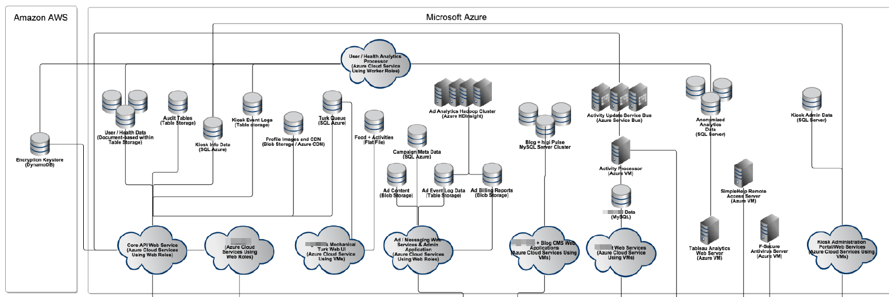
Customer – To Service Fabric or Not?
“If you create microservices in Azure, you do it in Service Fabric.”
Magic
“Service Fabric is the evolution of Cloud Services. It’s PaaS v2”
“I want to write code, not manage VMs.”
Notes:
The promise

Slide 70
Customer – To Service Fabric or Not?
“I want to manage code, not VMs.”
“I need to ship code . . . Now!”
DevLaptop
DevLaptop
DevLaptop
DevLaptop
+
or
VMSS
Service Fabric
What the . . .
What size VMs/nodes?
How many node types / VMSS?
What’s the best strategy to patch the VMs?
How do I secure these VMs? SF management console?
What’s the best approach to monitor the VM health?
3-Node Dev Cluster
5-Node Production Cluster
“No time to try, test, try again to get cluster config right.”
Notes:
The reality
Red Flags

